Slide 1
Constructing scatter graphs
Graphical representations of data

Slide 2
how to use Oak lessons

Slide 3
I can construct scatter graphs from data presented in a number of different ways.

Slide 4
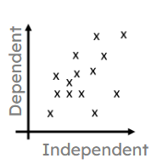
Bivariate data has two variables, where each data point for one variable has a corresponding data point for the other variable.
A scatter graph is a visual representation for bivariate data. It can be useful when determining the nature of the relationship between the variables.
An independent (explanatory) variable is a measure that is predicted to have an effect on another variable.
A dependent (response) variable is a measure whose value is predicted to be affected by an explanatory variable.

Slide 5

Constructing scatter graphs
Plotting bivariate data on a scatter graph
Deciding which axis to use for each variable

Slide 6




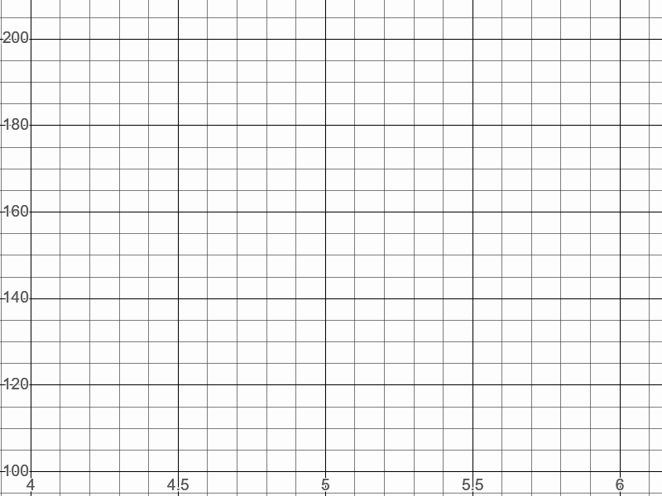
Plotting bivariate data on a scatter graph
Alex, Andeep, Izzy and Sam compete in a sport competition.
They plot their long jump distances on a graph.
Alex
Andeep
long jump (m)
Izzy
Sam
What observations could we make from this data?

Slide 7
Plotting bivariate data on a scatter graph
They plot their high jump distances on another graph.
high jump (cm)
Alex
Andeep
What observations could we make from this data?
Izzy
Sam

Slide 8
Plotting bivariate data on a scatter graph
They look at both graphs side-by-side.
high jump (cm)
long jump (m)
What connections could be made between the two sets of data?

Slide 9
Plotting bivariate data on a scatter graph
Each person has two values of data that can be combined to make a pair of bivariate data.
long jump: 4.8 m high jump: 148 cm
Alex
Bivariate data compares the values of two variables by pairing each value of one of the variables with a value of the other.
Bivariate data can be represented together in the same graph by plotting a scatter graph.

Slide 10
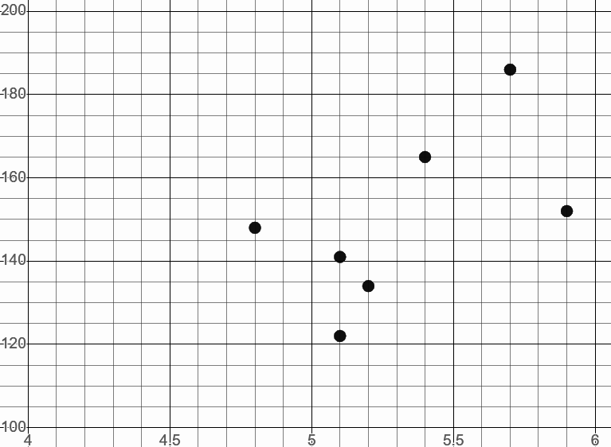
Plotting bivariate data on a scatter graph
Bivariate data can be represented on a scatter graph by plotting points.
high jump (cm)
 | long jump (m) | high jump (cm)
Alex | 4.8 | 148
Andeep | 5.4 | 165
Sam | 5.7 | 186
long jump (m)
Each point represents a pair of bivariate data.

Slide 11
Plotting bivariate data on a scatter graph
Data can be added to the scatter graph by plotting points.
high jump (cm)
 | long jump (m) | high jump (cm)
Jacob | 5.9 | 135
Laura | 5.3 | 173
135
5.9
long jump (m)

Slide 12
Plotting bivariate data on a scatter graph
Which person’s data is highlighted in the scatter graph?
high jump (cm)
 | long jump (m) | high jump (cm)
Izzy | 5.1 | 122
Aisha | 5.9 | 152
Sophia | 5.2 | 134
Aisha
long jump (m)

Slide 13
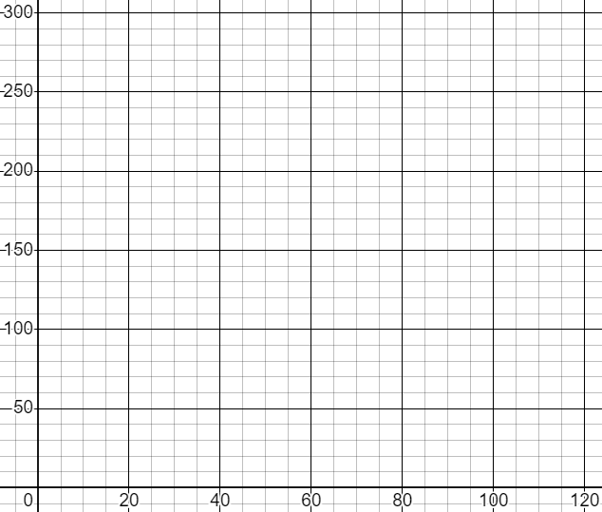
Plotting bivariate data on a scatter graph
1) The table shows weather data from Bradford, for five months in 2021. Plot this data on a scatter graph.
Month | Total rainfall (mm) | Total sunshine (hours)
Feb | 100 | 66
Apr | 16 | 216
Jun | 22 | 173
Aug | 61 | 126
Oct | 93 | 86
total sunshine (hours)
total rainfall (mm)

Slide 14
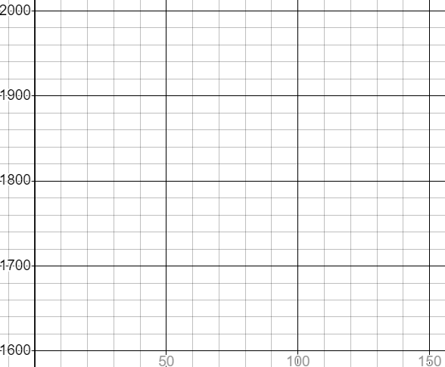
Plotting bivariate data on a scatter graph
2) Jacob runs a series of long-distance races. For each race, he records his time and the elevation of the course. Plot Jacob’s data on the scatter graph.
elevation (m) | time (s)
51 | 1756
4 | 1644
35 | 1735
115 | 1911
96 | 1870
time (s)
elevation (m)

Slide 15
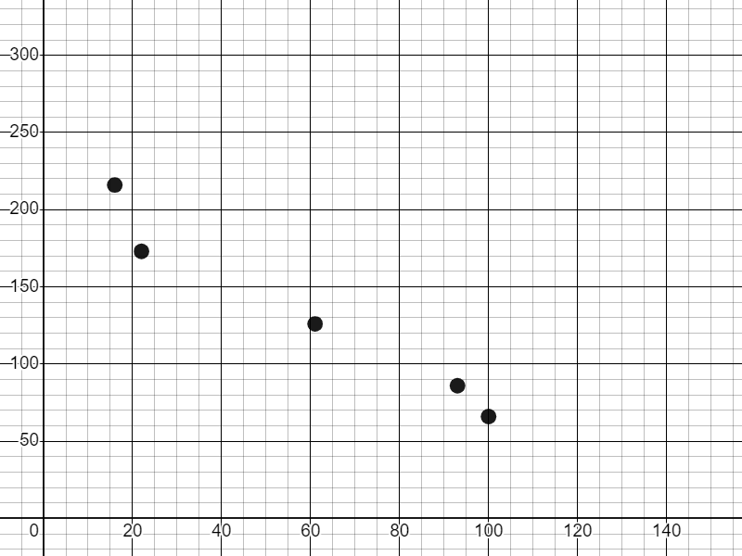
Plotting bivariate data on a scatter graph
1) The table shows weather data in Bradford, for five months in 2021. Plot this data on a scatter graph.
Month | Total rainfall (mm) | Total sunshine (hours)
Feb | 100 | 66
Apr | 16 | 216
Jun | 22 | 173
Aug | 61 | 126
Oct | 93 | 86
total sunshine (hours)
total rainfall (mm)

Slide 16
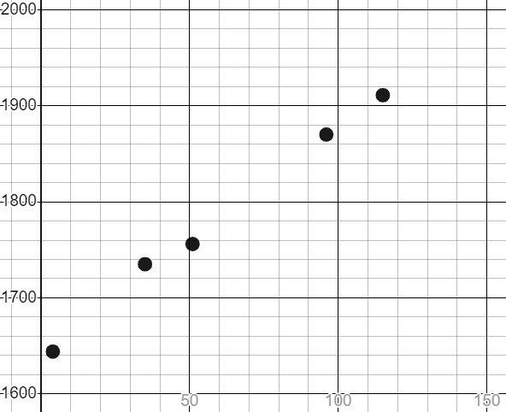
Plotting bivariate data on a scatter graph
2) Jacob runs a series of long-distance races. For each race, he records his time and the elevation of the course. Plot Jacob’s data on the scatter graph.
elevation (m) | time (s)
51 | 1756
4 | 1644
35 | 1735
115 | 1911
96 | 1870
time (s)
elevation (m)

Slide 17
Constructing scatter graphs
Plotting bivariate data on a scatter graph
Deciding which axis to use for each variable

Slide 18


Deciding which axis to use for each variable
Lucas conducts an experiment where he times how long a kettle takes to boil for different volumes of water.
Water (l) | 0.25 | 0.5 | 0.75 | 1 | 1.25 | 1.5
Time (s) | 34 | 59 | 90 | 143 | 188 | 237
What observations could Lucas make from this data?
The volume of water appears to be affecting the amount of time it takes for the kettle to boil.

Slide 19
Deciding which axis to use for each variable
In some cases with bivariate data, we might predict that one variable is affecting the values of the other.
In these cases, we can describe the variable that is predicted to be affecting the other as the explanatory variable.
The variable that is being affected is the response variable.
explanatory variable
response variable

Slide 20
Deciding which axis to use for each variable
Water (l) | 0.25 | 0.5 | 0.75 | 1 | 1.25 | 1.5
Time (s) | 34 | 59 | 90 | 143 | 188 | 237
The volume of water appears to be affecting the amount of time it takes for the kettle to boil.
volume of water in a kettle
time it takes for the kettle to boil
explanatory variable
response variable

Slide 21
Deciding which axis to use for each variable
Alternatively, one variable could be described as independent and the other as dependent.
In these cases, it is predicted that the value of the dependent variable is affected by changes to the independent variable.
independent variable
dependent variable

Slide 22
Deciding which axis to use for each variable
volume of water in a kettle
time it takes for the kettle to boil
independent variable
dependent variable
I can choose how much water I put in the kettle.
The time it takes for the kettle to boil depends on how much water I put in it.

Slide 23


Deciding which axis to use for each variable
Sophia and Aisha are analysing some bivariate data about ice cream sales in a day and the maximum temperature for each day.
They are trying to decide which is the dependent and independent variable.
ice cream sales
maximum temperature
independent variable
dependent variable
This would suggest that if a vendor sells more ice creams then the day may get hotter.
That does not seem right.

Slide 24
Deciding which axis to use for each variable
Sophia and Aisha are analysing some bivariate data about ice cream sales in a day and the maximum temperature for each day.
They are trying to decide which is the dependent and independent variable.
ice cream sales
maximum temperature
dependent variable
independent variable
This would suggest that if the day is hotter then a vendor may sell more ice creams.
That seems more reasonable.

Slide 25
Deciding which axis to use for each variable
Sometimes it is not clear which is the independent variable and which is the dependent variable.
Example:
wind speed
amount of rain
It is not always the case that two variables are connected.
Even if they seem to be connected, it does not necessarily mean that one is having an effect the other.
In these cases, we may avoid defining the variables using the terms independent/explanatory and dependent/response.

Slide 26

Deciding which axis to use for each variable
Which two terms describe a variable that is predicted to be affected by another variable?
dependent variable
explanatory variable
independent variable
response variable

Slide 27
Deciding which axis to use for each variable
Which two terms describe a variable that is predicted to be affecting another variable?
dependent variable
explanatory variable
independent variable
response variable

Slide 28
Deciding which axis to use for each variable
An athlete times how long it takes to complete obstacle courses of varying lengths. Which is the dependent variable?
course length
course length (m) | time to complete (s)
200 | 306
time to complete
neither

Slide 29
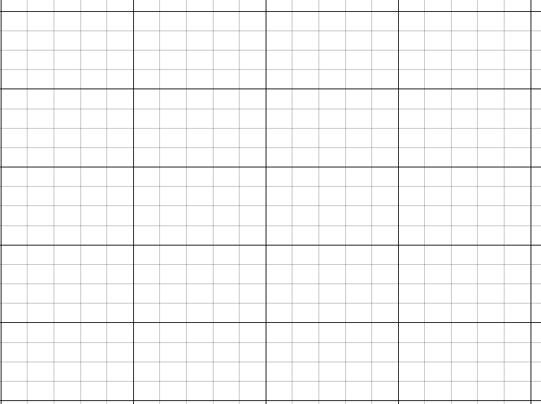
Deciding which axis to use for each variable
Lucas wants to plot his data on a scatter graph.
Water (l) | 0.25 | 0.5 | 0.75 | 1 | 1.25 | 1.5
Time (s) | 34 | 59 | 90 | 143 | 188 | 237
Which data should I label on each axis?

Slide 30
Deciding which axis to use for each variable
When plotting bivariate data consisting of an independent variable and dependent variable, the order of the axes is important.
The horizontal axis is used for the independent variable.
The vertical axis is used for the dependent variable.
dependent variable
independent variable

Slide 31
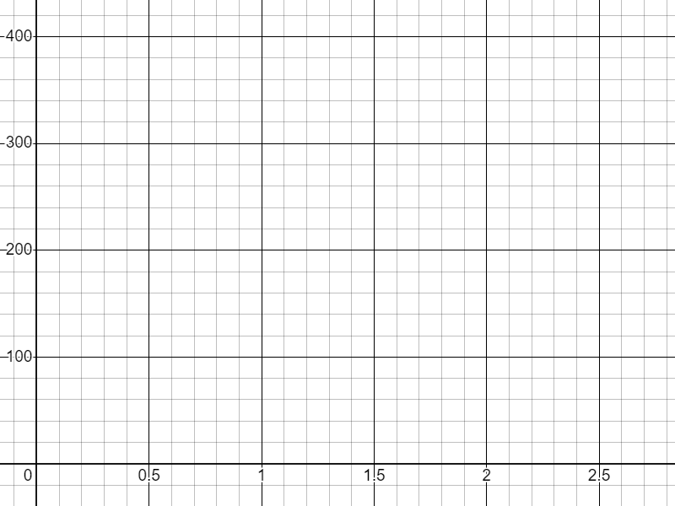
Deciding which axis to use for each variable
volume of water in a kettle
time it takes for the kettle to boil
independent variable
dependent variable
time (s)
volume (l)

Slide 32
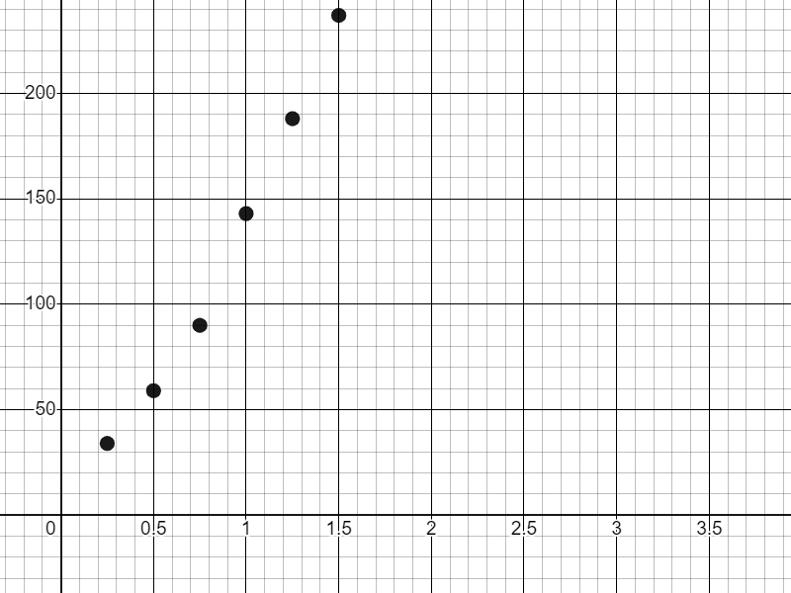
Deciding which axis to use for each variable
Water (l) | 0.25 | 0.5 | 0.75 | 1 | 1.25 | 1.5
Time (s) | 34 | 59 | 90 | 143 | 188 | 237
I’ve plotted my points but there are two missing.
Why are there two points missing from the scatter graph?
time (s)
The axis for time only goes up to 150 but there are two times greater than this.
volume (l)

Slide 33
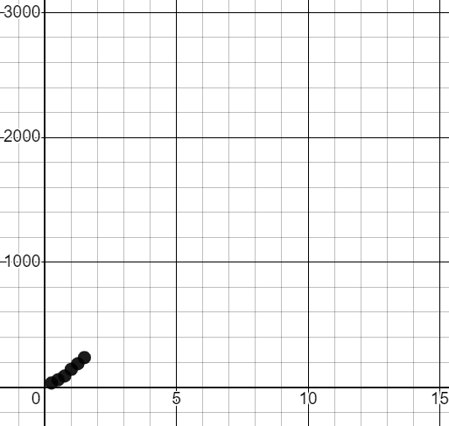
Deciding which axis to use for each variable
Water (l) | 0.25 | 0.5 | 0.75 | 1 | 1.25 | 1.5
Time (s) | 34 | 59 | 90 | 143 | 188 | 237
I’ve plotted my points but they are all bunched together.
Why is there so much unused space on the scatter graph?
time (s)
The axes go up to numbers far beyond the limits of the data.
volume (l)

Slide 34
Deciding which axis to use for each variable
Water (l) | 0.25 | 0.5 | 0.75 | 1 | 1.25 | 1.5
Time (s) | 34 | 59 | 90 | 143 | 188 | 237
What scale should I choose for each axis?
maximum water: 1.5
time (s)
3 large squares
interval size: 0.5
volume (l)

Slide 35
Deciding which axis to use for each variable
Water (l) | 0.25 | 0.5 | 0.75 | 1 | 1.25 | 1.5
Time (s) | 34 | 59 | 90 | 143 | 188 | 237
What scale should I choose for each axis?
maximum time: 237
time (s)
3 large squares
interval size: 100
volume (l)

Slide 36
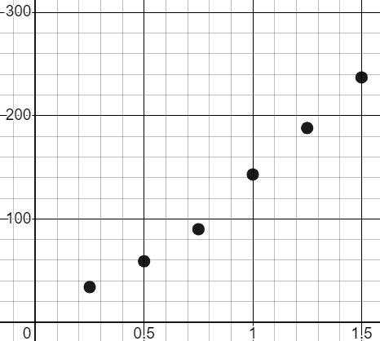
Deciding which axis to use for each variable
Water (l) | 0.25 | 0.5 | 0.75 | 1 | 1.25 | 1.5
Time (s) | 34 | 59 | 90 | 143 | 188 | 237
Now the scatter graph is ready to plot the data.
time (s)
volume (l)

Slide 37
Deciding which axis to use for each variable
Which variable from this data should go on the horizontal axis of a scatter graph?
course length (m) | time to complete (s)
200 | 306
course length
time to complete
either

Slide 38
Deciding which axis to use for each variable
Which would be the most appropriate scale for the vertical axis for this data?
total sunlight (hours)
189.5
143.1
147.6
64.5
46.2
34.4
200
Going up in 20s
150
Going up in 50s
total sunshine (hours)
100
50
Going up in 200s
0

Slide 39
Deciding which axis to use for each variable
1) For each pair of bivariate data, determine which is the independent variable and which is the dependent variable.
dependent
Example: ice cream sales maximum temperature of day
independent
a) amount of water in a kettle (ml) time it take for the kettle to boil (s)
b) time it takes to complete a running course (s) steepness of the running course (m)
c) age of a child (years) height of the child (m)
d) number of floods reported in a month amount of rainfall in the month (mm)

Slide 40
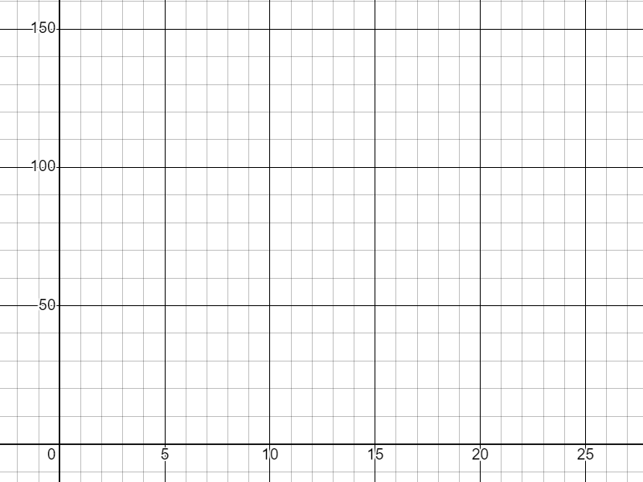
Deciding which axis to use for each variable
2) The data below shows the age and heights for a sample of six children. Plot the data on a scatter graph.
ages (years) | height (cm)
2 | 81
3 | 91
5 | 112
6 | 120
7 | 124
11 | 138

Slide 41
Deciding which axis to use for each variable
1) For each pair of bivariate data, determine which is the independent variable and which is the dependent variable.
dependent
Example: ice cream sales maximum temperature of day
independent
independent
a) amount of water in a kettle (ml) time it take for the kettle to boil (s)
b) time it takes to complete a running course (s) steepness of the running course (m)
c) age of a child (years) height of the child (m)
d) number of floods reported in a month amount of rainfall in the month (mm)
dependent
dependent
independent
independent
dependent
dependent
independent

Slide 42
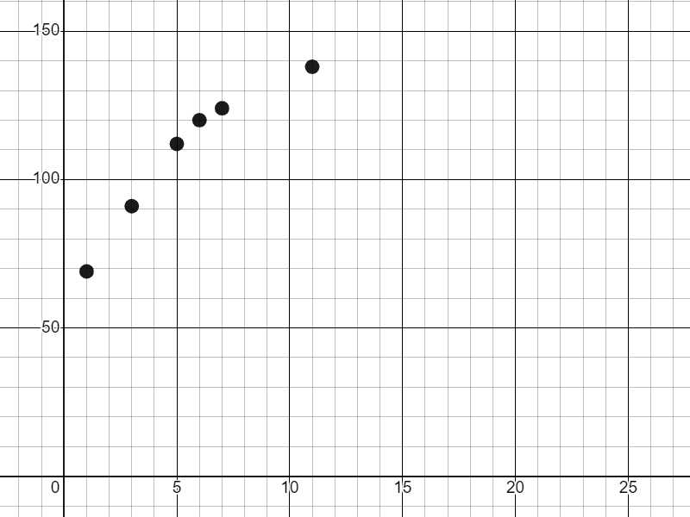
Deciding which axis to use for each variable
2) The data below shows the age and heights for a sample of six children. Plot the data on a scatter graph.
ages (years) | height (cm)
2 | 81
3 | 91
5 | 112
6 | 120
7 | 124
11 | 138
height (cm)
age (years)

Slide 43
Constructing scatter graphs
Data presented as a paired list can be represented as a scatter graph.
Data presented in a table can be presented as a scatter graph.
The independent variable is placed on the horizontal axis.
The dependent variable is placed on the vertical axis.

Slide 44

© Oak National Academy 2023.
Produced in partnership with Mathematics in Education and Industry.
Licensed on the Open Government Licence v3.0, except where otherwise stated. See Oak terms and conditions.

